Slide 1

Cmr Institute of technology (Ugc Autonomous)
Approved by AICTE | Acciratedd by NAAC with 'A' Grede
All B. Tech programs accirated by NBA

Slide 2
NOVEL VEDIC MATHEMATICS BASED ALU USING SPECIFIC REVERSABLE GATES
Guide:
Dr.K.NIRANJAN REDDY
(Professor, HOD, department of ece).
PRESENTED BY:
SUSHMA REDDY. J
19R01D5702.

Slide 3
ABSTRACT
This project utilizes the computational speed advantages of vedic algorithm and energy optimization benefits of reversible circuit. The vedic algorithm optimizes the conventional mathematic computation logic used in the current processors thereby, effectively increasing the speed of computation.

Slide 4
LITTERATURE SURVEY
Priyal Grover and Hemant Verma [1] present paper “Design,
Layout and Simulation of 8 Bit Arithmetic and Logic Unit (2015)”
in International Journal of Electrical and Electronics Engineers.
In this presented work, an 8-bit ALU is designed
Avinash G. Keskar and Vishal R. Satpute [8] present paper
“Design of Eight Bit Novel Reversible Arithmetic and Logic Unit
(2011)” in IEEE. This paper covers various aspects about
reversible computing and reversible logic gates. Furthermore in
this paper we have tried to design a reversible implementation
of eight bit arithmetic and logic unit, optimal in terms of
number of gates used and number of garbage outputs
produced. This ALU has more operation and complex in design.

Slide 5
EXISTING SYSTEM
In the existed system the main problem is we are implemented alu with logic gates and different kind of adders

Slide 6
PROPOSED SYSTEM:
This project is emphasized the use of reversibility in circuits design for reduction in power dissipation, while successfully demonstrating the same.
However this reduction in power was also followed by significant reduction in speed as well as increase in chip area.
Hence smarter algorithm and logic design was required to speed up the execution of a logic module. With this reference, 'Vedic Algorithm' technique.
While there are as many as 16 techniques(sutras) in the Vedic algorithm, the proposed design will implement multiplier using the popular Urdhva method (Urdhva Triyambakam).

Slide 7
TOOLS using:
SOFTWARE : XILINX 14.5
PROGRAMMING: VERILOG

Slide 8
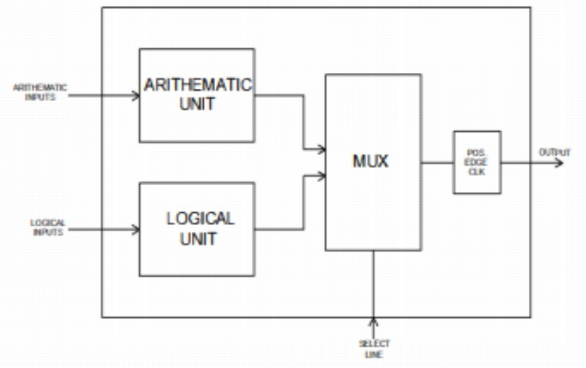
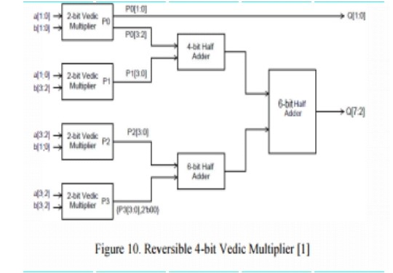
BLOCK DIAGRAM

Slide 9
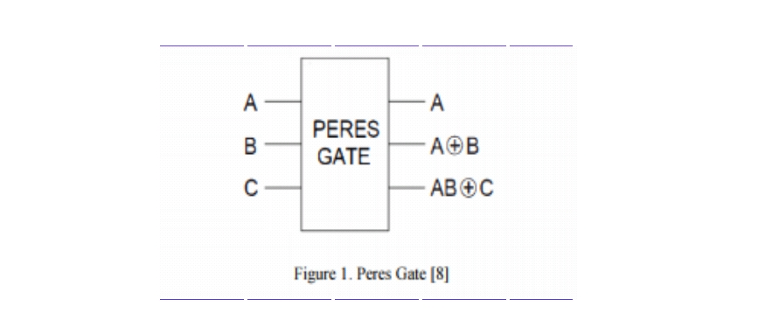
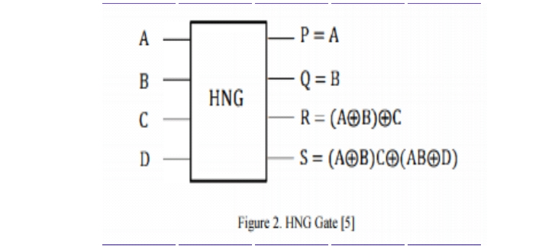
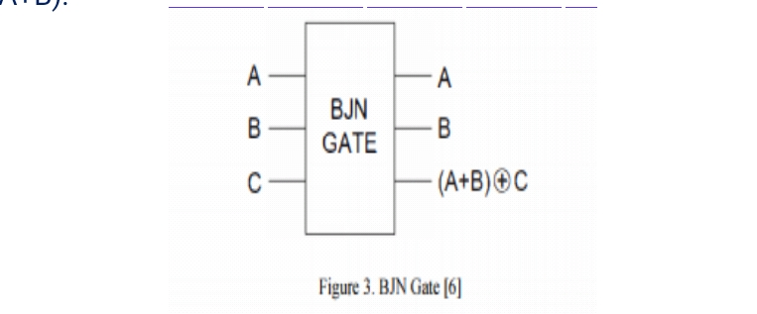
REVERSABLE GATES
PERES GATE
HNG GATE
BJN GATE

Slide 10
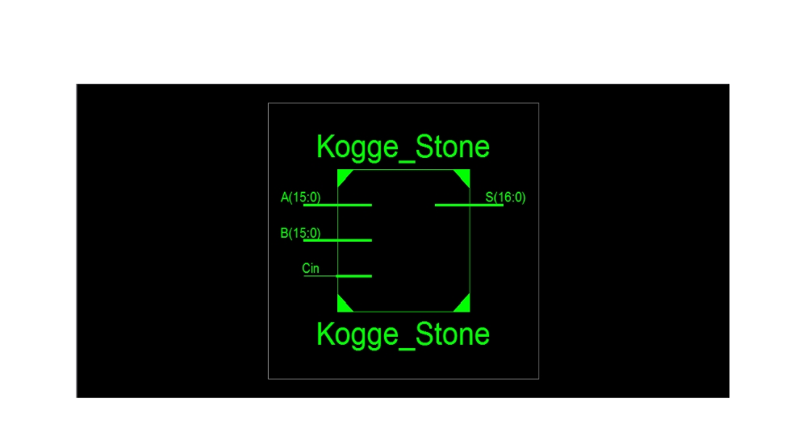
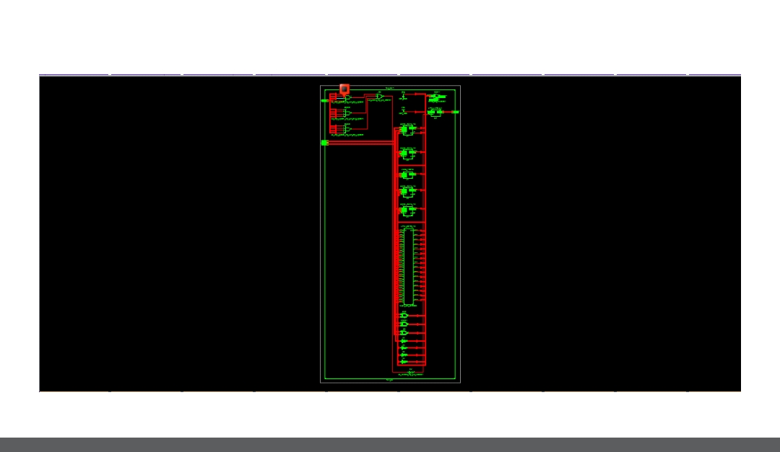
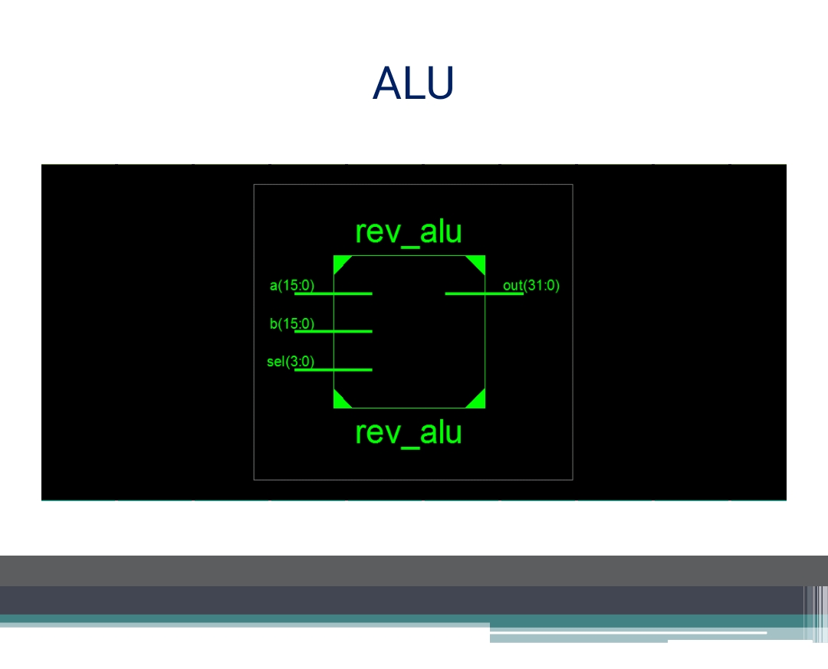
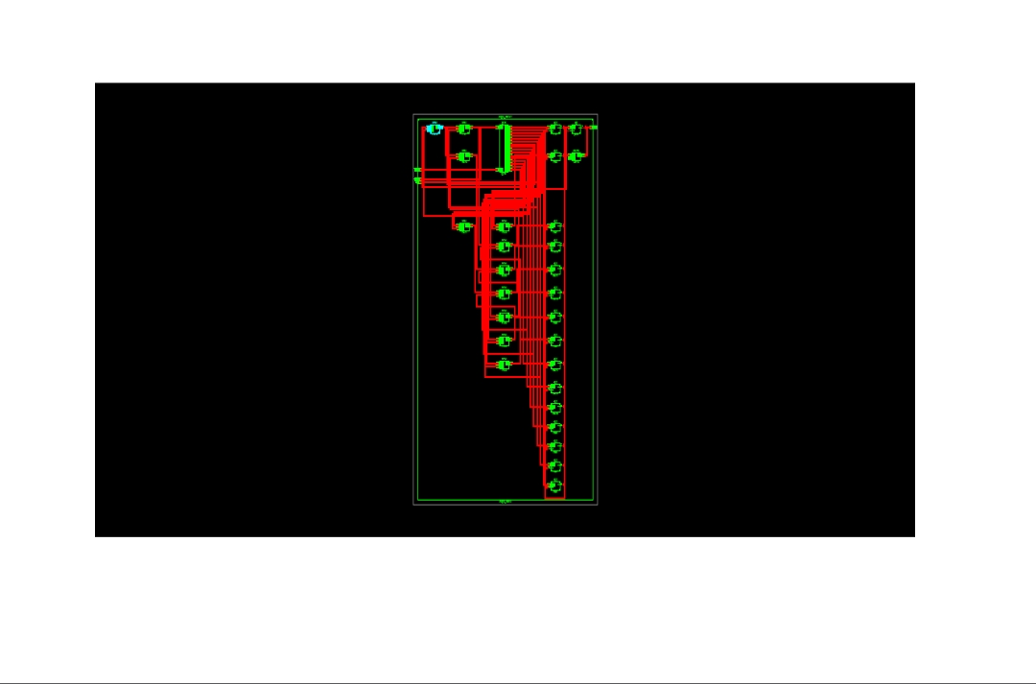
RTL AND SIMULATIION RESULT

Slide 11
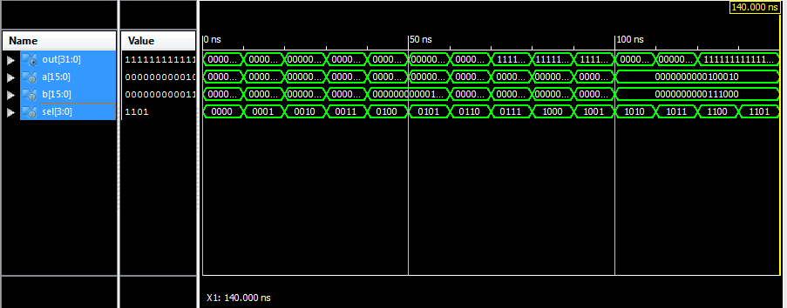
Rev alu

Slide 12
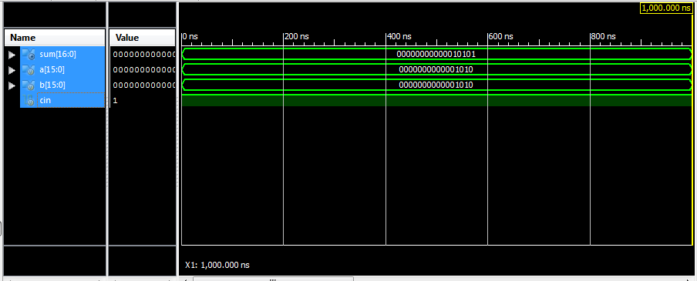
Kogge stone adder

Slide 13
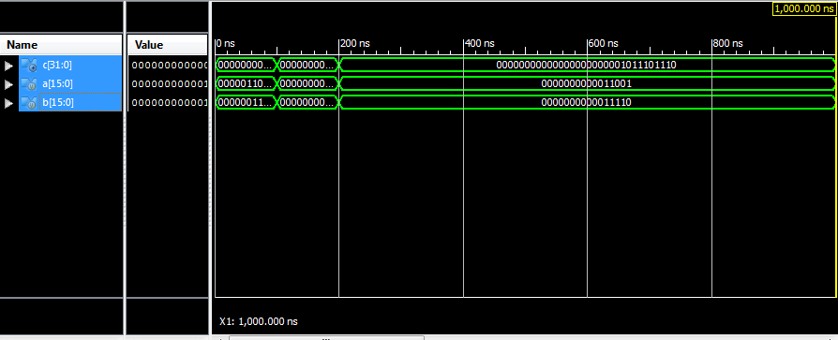
Vedic multiplier

Slide 14
APPLICATIONS
ALU applications
Signal processing or mixing applications
. Dsp signal

Slide 15
ADVANTAGES
Low power
Speed of operation increases
Low delay
. Less area

Slide 16
CONCLUSION
Successfully establishes the power and area advantages brought forward by selective reversal as well as faster algorithm based on Vedic method. This technique can also be applied for any other reversable circuit designing, where the area and power requirement's are stringent.

Slide 17
THANK YOU

